Slide 1
Arthrocentesis
Asses. Prof. Dr. Rafid Majeed

Slide 2
Arthrocentesis involves puncture and aspiration of joint fluid.
Inspirated fliuds may be used for diagnosis including
Fluid grossly inspected,
Fluid culture, or
analyzing for cell types and numbers, protein, viscosity, and glucose content.
In addition, arthrocentesis allows instillation of dye, or air for arthrography.
it may be used for treatment including
Its used to relief of pain by aspirating effusion or blood,
Injection of medications (corticosteroids, antibiotics, chemotherapy or anesthesia)
Drainage of septic effusion

Slide 4
Equipments
Sterile gloves and drapes
Gauze pads 4×4
Skin preparatory solution
Lidocain 1%
Syringes 5 ml, 20 ml, 30 ml,
Needles 18-25
Specimen tubes
Bandages

Slide 5
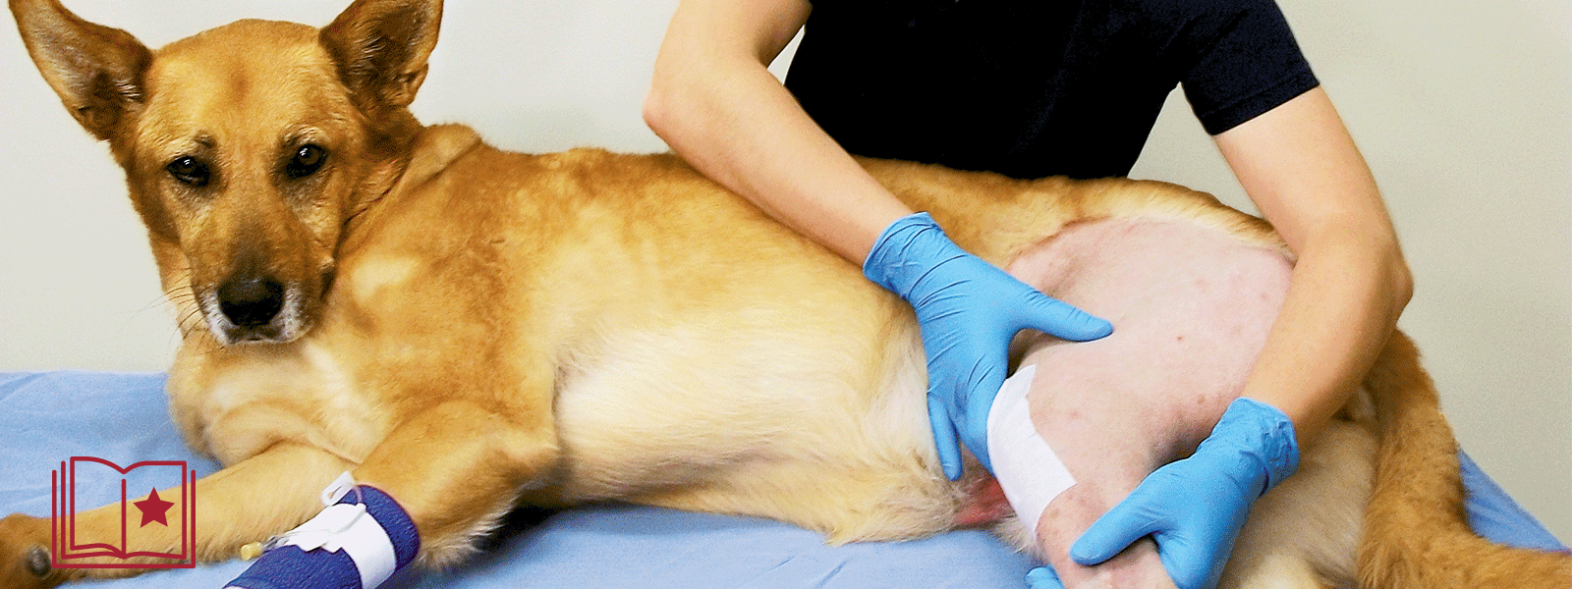
Animal preparation
Informed consent
Identification of needle insertion site and marking it
Skin preparation
Local anesthesia lidocain 1%

Slide 6
the hair is clipped and surgical scrub applied. Spinal needles (18-22 gauge) are used.
Care must be taken to avoid scratching the articular surfaces and make a “clean” puncture to avoid blood contamination.
The appearance of joint fluid confirms proper needle placement. If no fluid appears, the needle is reintroduced in the same region, moved slightly, or approached from the other side of the joint if possible.
Often, with swollen inflamed joints (rheumatoid arthritis), minimal extracellular fluid is present

Slide 7
The injection techniques for various arthrocentesis sites are as follows:
1. Arthrocentesis of the coxofemoral joint. The needle is introduced proximal and cranial to the trochanter major and is directed somewhat ventrally.

Slide 8
Arthrocentesis of the stifle joint. With the knee flexed, the needle is introduced just medial or lateral to the mid portion of the straight patellar ligament.

Slide 9
Arthrocentesis of the tarsocrural joint. With the hock held in extension, the needle is introduced lateral to the fibular tarsal bone and aimed toward the middle of the joint.

Slide 10
Arthrocentesis of the scapulohumeral joint. The needle is introduced about 1 cm distal to the acromion process of the scapula.
If no fluid is obtained, an assistant may gently pull the forearm distally to “open” the joint space.

Slide 11
Arthrocentesis of the elbow joint. With the elbow in extension, the needle is introduced just lateral to the olecranon.

Slide 12
Arthrocentesis of the carpal joint. The joint lies on the same level as the base of the accessory carpal bone. With the joint flexed, the needle is introduced at the midline of the joint.

Slide 14
Complication
Infection
Hemarthrosis
Damage to articular cartilage
Damage to the adjacent nerves and vessels

